Slide 1
Ch. 26 (2)
Saving, Investment, and the Financial System

Slide 2
Financial Institutions
Financial system
Group of institutions in the economy
That help match one person’s saving with another person’s investment
Moves the economy’s scarce resources from savers to borrowers
Financial institutions
1. Financial markets (bond & stock markets)
2. Financial intermediaries(banks, mutual funds)

Slide 3
Financial Institution-1. Financial Markets
1. Financial markets
Savers can directly provide funds to borrowers
The bond market
The stock market

Slide 4
Financial Institution-1. Financial Markets
The bond market
Bond: certificate of indebtedness
Date of maturity, when the loan will be repaid
Rate of interest, paid periodically until the date of maturity
Principal, amount borrowed
Borrowing from the public
Used by large corporations, the federal government, or state and local governments

Slide 5
Financial Institution-1. Financial Markets
Bonds differ according to characteristics:
Term: length of time until maturity
A few months, 30 years, perpetuity
Long-term bonds are riskier than short-term bonds
Long-term bonds usually pay higher interest rates

Slide 6
Financial Institution-1. Financial Markets
Bonds differ according to characteristics
Credit risk: probability of default
Probability that the borrower will fail to pay some of the interest or principal
Higher interest rates for higher probability of default
U.S. government bonds tend to pay low interest rates
Junk bonds, very high interest rates: issued by financially shaky corporations

Slide 7
Financial Institution-1. Financial Markets
Bonds differ according to characteristics
Tax treatment: interest on most bonds is taxable income
Municipal bonds
Issued by state and local governments
Owners are not required to pay federal income tax on the interest income
Lower interest rate

Slide 8
Financial Institution-1. Financial Markets
The stock market
Stock: claim to partial ownership in a firm
A claim to the profits that a firm makes
Organized stock exchanges ----NY Stock Exchange, National Association of Securities Dealers Automated Quotations (NASDAQ)
Stock prices: demand and supply
Equity finance
Sale of stock to raise money
Stock index
Average of a group of stock prices

Slide 9
Financial Institution- 2. Financial Intermediaries
2. Financial intermediaries
Savers can indirectly provide funds to borrowers
Banks
Mutual funds
An institution that sells shares to the pubic and uses the proceeds to buy a portfolio or various types of stocks and bonds.

Slide 10
Financial Intermediaries, Part 2
Banks
Take in deposits from savers
Banks pay interest
Make loans to borrowers
Banks charge interest
Facilitate purchasing of goods and services
Checks: medium of exchange

Slide 11

Financial Intermediaries, Part 3
Mutual funds
Institution that sells shares to the public
Uses the proceeds to buy a portfolio of stocks and bonds
Advantages: diversification; professional money managers

Slide 12
Financial institutions (bond market, stock market, banks, and mutual funds) have the role of coordinating the economy’s saving and investment.

Slide 13
National Income Accounts
Rules of national income accounting
Important identities
Identity
An equation that must be true because of the way the variables in the equation are defined
Clarify how different variables are related to one another

Slide 14
Accounting Identities, Part 1
Gross domestic product (GDP, Y)
Total income = Total expenditure
Y = C + I + G + NX
Y = gross domestic product, GDP
C = consumption
I = investment
G = government purchases
NX = net exports

Slide 15
Accounting Identities, Part 2
Closed economy
Doesn’t interact with other economies
NX = 0
Open economy
Interacts with other economies
NX ≠ 0

Slide 16
Accounting Identities, Part 3
Assume closed economy: NX = 0
Y = C + I + G
National saving (saving), S
Total income in the economy that remains after paying for consumption and government purchases
Y – C – G = I
S = Y – C – G
S = I

Slide 17
Accounting Identities, Part 4
National Saving
S = Y – C – G or
S = (Y – T – C) + (T – G)
T = taxes minus transfer payments
Private saving, Y – T – C
Income that households have left after paying for taxes (disposable income, Y-T) and consumption (C)
Public saving, T – G
Tax revenue that the government (T) has left after paying for its spending (G)

Slide 18
Accounting Identities, Part 5
Budget surplus: T – G > 0
Excess of tax revenue over government spending
Budget deficit: T – G < 0
Shortfall of tax revenue from government spending

Slide 19
Saving and Investing
Accounting identity: S = I
Saving = Investment
For the economy as a whole
One person’s savings can finance another person’s investment

Slide 20
Active Learning 1 Calculations
Suppose GDP equals $10 trillion, consumption equals $6.5 trillion, the government spends $2 trillion and has a budget deficit of $300 billion.
Find public saving, private saving, national saving, and investment.
Notes:
This exercise asks your students to apply the concepts from the preceding slides to the kind of problem they might see on an upcoming exam.

Slide 21
Active Learning 1
Given: Y = 10.0, C = 6.5, G = 2.0,
G – T = 0.3 (budge deficit)
(all in trillions)
Public saving =
Private saving =
T = G - 0.3 = 2 - 0.3 = 1.7
National saving S=
Investment =
T – G = – 0.3
Y–T–C = 10 – 1.7 – 6.5 = 1.8
Y–C–G = 10 – 6.5 – 2 = 1.5
national saving = 1.5
Notes:
All numbers are in trillions of dollars.

Slide 22
The Market for Loanable Funds
Loanable funds market
A supply–demand model of the financial system
Helps us understand:
How the financial system coordinates saving & investment.
How government policies and other factors affect saving, investment, the interest rate.

Slide 23
The Market for Loanable Funds
Assume: only one financial market
All savers deposit their saving in this market.
All borrowers take out loans from this market.
There is one interest rate, which is both the return to saving and the cost of borrowing.
Notes:
In defense of the assumption of just one financial market:
We are using this model to study the aggregate financial system. It’s fine to assume there’s only one type of asset as long as we don’t need to know how households divide their financial wealth into various types of assets.
An analogy might help. Suppose you want to know how a fall in consumer income affects the automobile market. You could draw a supply–demand model for autos, in which the demand curve would shift leftward, causing the price and quantity to fall. Of course, this model ignores the fact that there are lots of different types of vehicles, but that isn’t relevant to the issue at hand.

Slide 24
The Market for Loanable Funds
The supply of loanable funds comes from saving:
Households with extra income can loan it out and earn interest.
Public saving
If positive, adds to national saving and the supply of loanable funds.
If negative, it reduces national saving and the supply of loanable funds.

Slide 25
The Slope of the Supply Curve
An increase in the interest rate makes saving more attractive, which increases the quantity of loanable funds supplied.
Interest Rate
Supply
6%
3%
60
80
Loanable Funds ($billions)
Notes:
25

Slide 26
The Market for Loanable Funds
The demand for loanable funds comes from investment:
Firms borrow the funds they need to pay for new equipment, factories, etc.
Households borrow the funds they need to purchase new houses.

Slide 27
The Slope of the Demand Curve
A fall in the interest rate reduces the cost of borrowing, which increases the quantity of loanable funds demanded.
Interest Rate
7%
4%
Demand
50
80
Loanable Funds ($billions)
Notes:
27

Slide 28
Equilibrium
The interest rate adjusts to equate supply and demand.
The equilibrium quantity of loanable funds equals equilibrium investment and equilibrium saving.
Interest Rate
Supply
5%
Demand
60
Loanable Funds ($billions)
Notes:
28
If the interest rate were lower than the equilibrium level, demand for funds would exceed supply, causing the interest rate to rise. The rise in the rate would make borrowing more costly, and thus would reduce the demand for funds. The rise in the interest rate would also encourage households to save more, which would increase the supply of funds. This process would occur until equilibrium was achieved.
If the interest rate were higher than equilibrium, there would be a surplus of funds. The interest rate would fall to restore equilibrium.
In the real world, the adjustment to equilibrium in financial markets is extremely rapid.

Slide 29
Policy 1
Saving Incentives
Example:
Tax deduction on retirement funds.
How would the tax deduction affect in loanable funds market?
How would the supply for loanable funds change?

Slide 30
Policy 1: Saving Incentives
Tax incentives for saving increase the supply of loanable funds
…which reduces the equilibrium interest rate
and increases the equilibrium quantity of loanable funds
Interest Rate
S₁
S₂
5%
4%
D₁
60
70
Loanable Funds ($billions)
Notes:
30
There’s an implicit assumption in this analysis that overall tax revenues remain unchanged in spite of the tax incentives. Taken literally, we would have to assume that other taxes are raised to exactly offset the loss in revenue from the saving incentives. Without this implicit assumption, total tax revenues would fall, causing saving to fall, and shifting the supply curve leftward, which would mitigate the effects shown here.
You may or may not wish to point this out to your students. If you are especially nitpicky, or your students are particularly sharp, then it’s probably worth telling them. (Note, however, that the assumption of constant total revenue remains implicit in the textbook’s discussion of this policy.)

Slide 31
Policy 1: Saving Incentives
Shelter some saving from taxation
Affect supply of loanable funds
Increase in supply
Supply curve shifts right
New equilibrium
Lower interest rate
Higher quantity of loanable funds
Greater investment

Slide 32
Policy 2
Investment Incentives
Example:
Investment tax credit
It gives tax advantage to any firms building a new factory or buying a new piece of equipment.
How would the investment tax credit affect in loanable funds market?
How would the demand for loanable funds change?

Slide 33
Policy 2: Investment Incentives
An investment tax credit increases the demand for loanable funds
…which raises the equilibrium interest rate
and increases the equilibrium quantity of loanable funds
Interest Rate
S₁
6%
5%
D₂
D₁
60
70
Loanable Funds ($billions)
Notes:
33
As with Policy 1, you may wish to note that we are assuming the tax credit does not significantly reduce the overall amount of taxes. If total taxes fell, then the supply curve would shift (in addition to the demand curve). However, our intention here is to focus solely on the demand shift.

Slide 34
Policy 2: Investment Incentives
Investment tax credit
Affect demand for loanable funds
Increase in demand
Demand curve shifts right
New equilibrium
Higher interest rate
Higher quantity of loanable funds
Greater saving

Slide 35
Active Learning 2 Budget deficits
Use the loanable funds model to analyze the effects of a government budget deficit:
-Draw the diagram showing the initial equilibrium.
-Determine which curve shifts when the government runs a budget deficit.
-Draw the new curve on your diagram.
-What happens to the equilibrium values of the interest rate and investment?
Notes:
Now that you have shown students the analysis of Policies 1 and 2, this exercise asks them to do the analysis of Policy 3 (a budget deficit).

Slide 36
Active Learning 2 (Incentive) Budget deficits
Interest Rate
A budget deficit reduces national saving and the supply of loanable funds
…which increases the equilibrium interest rate
and decreases the equilibrium quantity of loanable funds and investment.
S₂
S₁
6%
5%
D₁
50
60
Loanable Funds ($billions)
Notes:
Some students ask why the budget deficit shifts the S curve rather than the D curve; after all, governments finance their deficits by borrowing. The reason is that we have defined supply of loanable funds as the flow of resources available to fund private investment. The budget deficit reduces this supply of resources.
In the real world, we sometimes see increases in government budget deficits that are not accompanied by dollar-for-dollar decreases in investment, as the analysis on this slide would predict. Keep in mind, however, that the analysis here is for the closed economy model. In an open economy, firms can finance investment by borrowing from abroad in the face of a decrease in the domestic supply of loanable funds.
This, of course, does not mean that budget deficits are “okay” in an open economy, because the extra indebtedness requires service, such as interest or dividend payments, which reduces the amount of income remaining for residents of the country.

Slide 37
Policy 3: Budget Deficit
Crowding out
A decrease in investment that results from government borrowing.
Budget deficit →Decrease in supply (Supply curve shift left)
Higher interest rate
Decrease in investment (Moving along the demand curve). ---- Crowding out

Slide 38
Policy 3: Budget Deficit
Government – starts with balanced budget
Then starts running a budget deficit
Change in supply of loanable funds
Decrease in supply
Supply curve shifts left
Due to higher interest rate, investment decreases (moving along the demand curve): crowding out
New equilibrium
Higher interest rate
Smaller quantity of loanable funds

Slide 39
Policy 3: Budget Deficit/Surplus
Government – budget surplus
Increase supply of loanable funds
Reduce interest rate
Stimulates investment

Slide 40
The Market for Loanable Funds,
Government policies
Can affect the economy’s saving and investment
Saving incentives
Supply curve shifts right.
Investment incentives
Demand curve shifts right.
Government budget deficits and surpluses
Supply curve shifts left.
Government budget surpluses
Supply curve shift right.

Slide 41
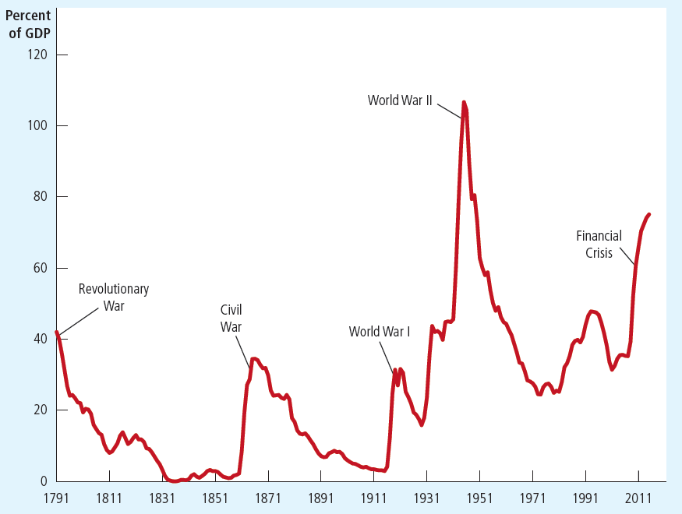
U.S. Government Debt as a Percentage of GDP 1790–2012
Notes:
The details below come from the case study ‘The history of U.S. government debt.’
Note that in recent years, debt/GDP is higher than at any time besides WW2, including all other wars.
From the beginning of this long time series until about 1980, the data show a clear pattern: the debt-GDP ratio jumps up during wartime, and comes back down during peacetime. (Also, the Great Depression caused revenues to plummet, and led to a rise in the debt ratio during the 1930s.)
There are two reasons why many economists believe it is appropriate to allow the debt ratio to climb during wars. First, it allows the government to keep tax rates smooth over time. Wars are expensive, and financing them solely with tax increases would be disruptive to the economy and would cause a substantial reduction in economic efficiency. Second, debt finance shifts part of the cost of the war to future generations. This is appropriate, one could argue, because future generations benefit when the government goes to war to defend the nation against foreign aggressors.
The pattern visible throughout most of history breaks down around 1980, when the debt ratio started climbing despite the lack of a major war. This was due to the Reagan tax cuts, and growth in federal entitlement outlays during the 1980s.
From 1992 to 2000, the longest expansion on record plus a strong stock market in 1995–2000 led to a surge in revenues, the first budget surpluses in many years, and a declining debt-GDP ratio.
From 2001–2005, the ratio to start climbing again due to the Bush tax cuts, the 2001 recession, and the wars (Afghanistan, Iraq, and the War on Terror).
The ratio shoots up dramatically in 2008–2012 due to the financial crisis and recession. (increase in the debt-to-GDP ratio from 39% in 2008 to 70% in 2012. )
After 2012, as the economy recovered, the budget deficits shrank, and the increases in the debt-to-GDP ratio became smaller
Sources: Same as text

Slide 42
The U.S. Government Debt
The government finances deficits by borrowing (selling government bonds).
Persistent deficits lead to a rising government debt.
The ratio of government debt to GDP
Useful measure of the government’s indebtedness relative to its ability to raise tax revenue.
Historically, the debt-GDP ratio usually rises during wartime and falls during peacetime—until the early 1980s.

Slide 43
Conclusion
Markets are usually a good way to organize economic activity
Financial markets: governed by the forces of supply and demand
Help allocate the economy’s scarce resources to their most efficient uses.
Link the present to the future
Savers: convert current income into future purchasing power
Borrowers: acquire capital to produce goods and services in the future
Notes:
It might be worth elaborating for a moment on “financial markets help allocate the economy’s scarce resources to their most efficient uses.”
The scarce resources this statement refers to are the loanable funds. They are scarce because there are more investment projects needing funding than funds available. So how should the scarce funds be allocated? I.e., which investment projects should get the available funds? The investment projects with the highest expected returns, of course. And the projects with the highest expected returns would have the highest willingness to pay for funds.
Hence, supply and demand for funds determines the equilibrium interest rate, and all projects with returns at or above that interest rate will be funded; the projects with expected returns below the interest rate will not be funded. In this way, the economy gets the most “bang” (future productive capacity) out of its investment “buck.” Just another reason why capitalism is such a beautiful thing!

